Slide 1
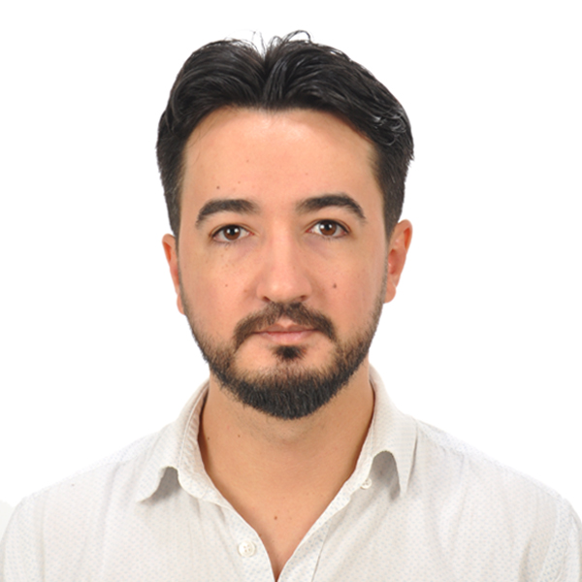
Introduction
Umut Celik Full-Stack Developer

Slide 2
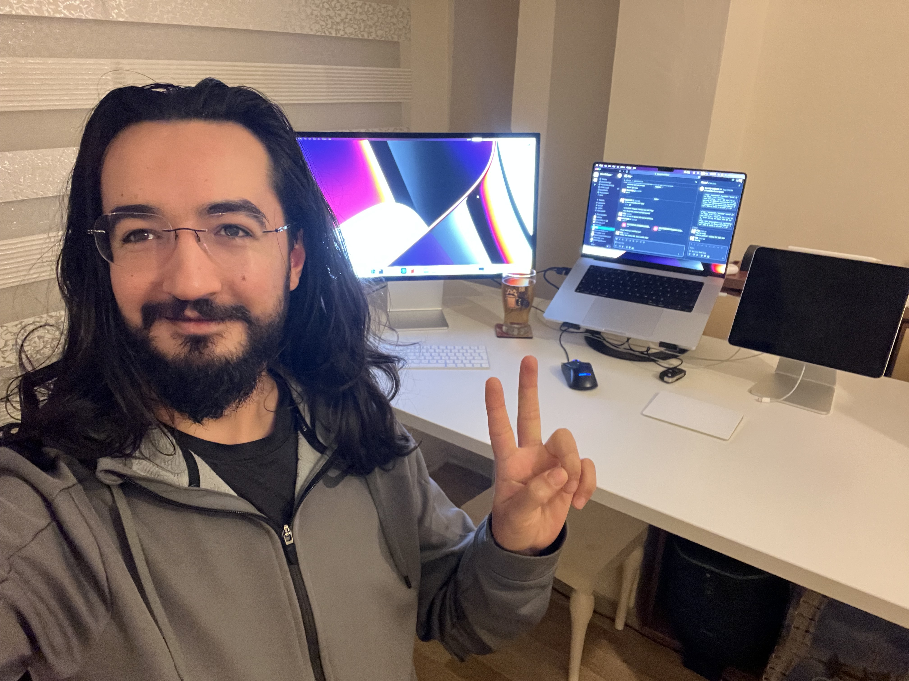
Background
I worked 5 years in educational technology, and 3 years in motorcycles industry as a software developer. - I haven’t worked yet on an image processing things even my companies has image processing projects. But after this class, I hope that will be part of this teams and projects. - I had statistics background to measure student results at ed tech company. I made lots of calculations for hundreds of students exam, homework, activities to evaluate and report them. - My coding background is generally on scripting languages (TypeScript/PHP) but this semester panning to learn C++. I also have strong cloud experience especially AWS(Amazon Web Services)

Slide 3
Research Interests
Educational Tech Industry:
Schools capture the student photos out of the school events. I could have a emotional analysis and sell them to the schools.
We have millions of static question books. I want to split(cut) all questions in a book with OpenCV and I want to make a personalized student books.
School has local cameras and they and we have GDPR compliance to process them. I would like to take inspection (attendance) automatically to save teacher’s time.
Schools has their own social networks and teacher/parent/sutudents shares lots of media and I would like to approve/reject mechanism via ComputerVision.
Motorcycle Industry:
I would like to analyze the motorcycle from the pictures and link to catalog (year/make/model/miles) and evaluate the retail price from the photo.

Slide 4

Why I’m take this class
Currently I’m not working on an image processing project but have plans. I take this class to fix real life problems and wish to have an idea to made SAAS/Start-up or be have a part of the good team.

Slide 5
Research Project
Develop a skin cancer detection and recognition system.

Slide 6
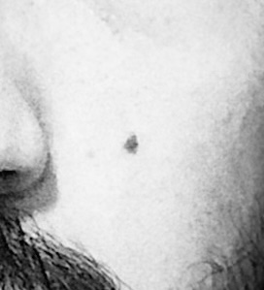
Develop a skin cancer detection and recognition system.
This project focuses on the detection and recognition of potential skin cancer lesions using digital image processing techniques. Leveraging dermoscopic or standard skin images, algorithms learned throughout the course will be applied for lesion segmentation, extraction of distinguishing features (such as color, shape, texture), and classification based on these features (e.g., benign/malignant). The goal is to develop a prototype computer-aided diagnosis system to assist in early detection.

Slide 7
Image algebra operations
Basic image algebra operations are the foundation of digital image processing
01
Operations operate pixel-by-pixel on grayscale intensity values
02
Important to understand data types and proper handling of value ranges
03

Slide 8
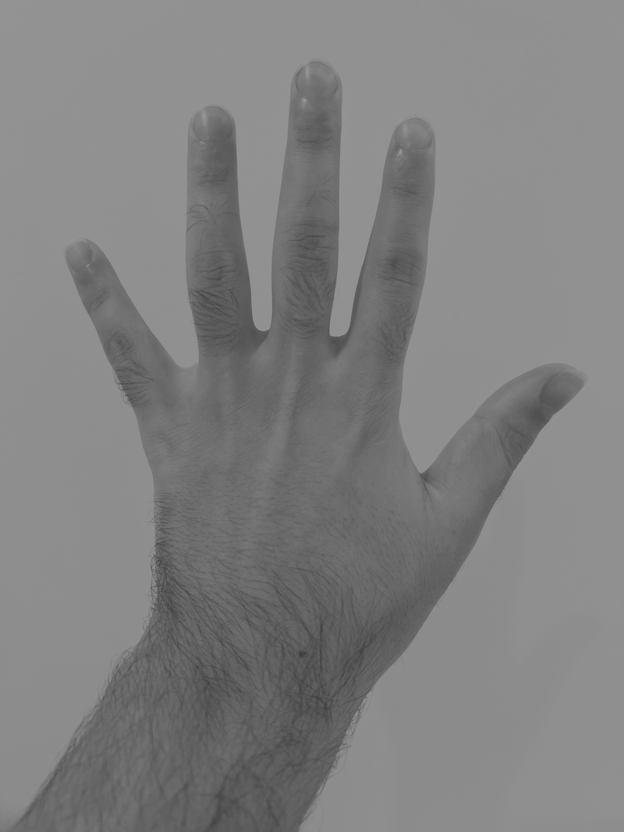
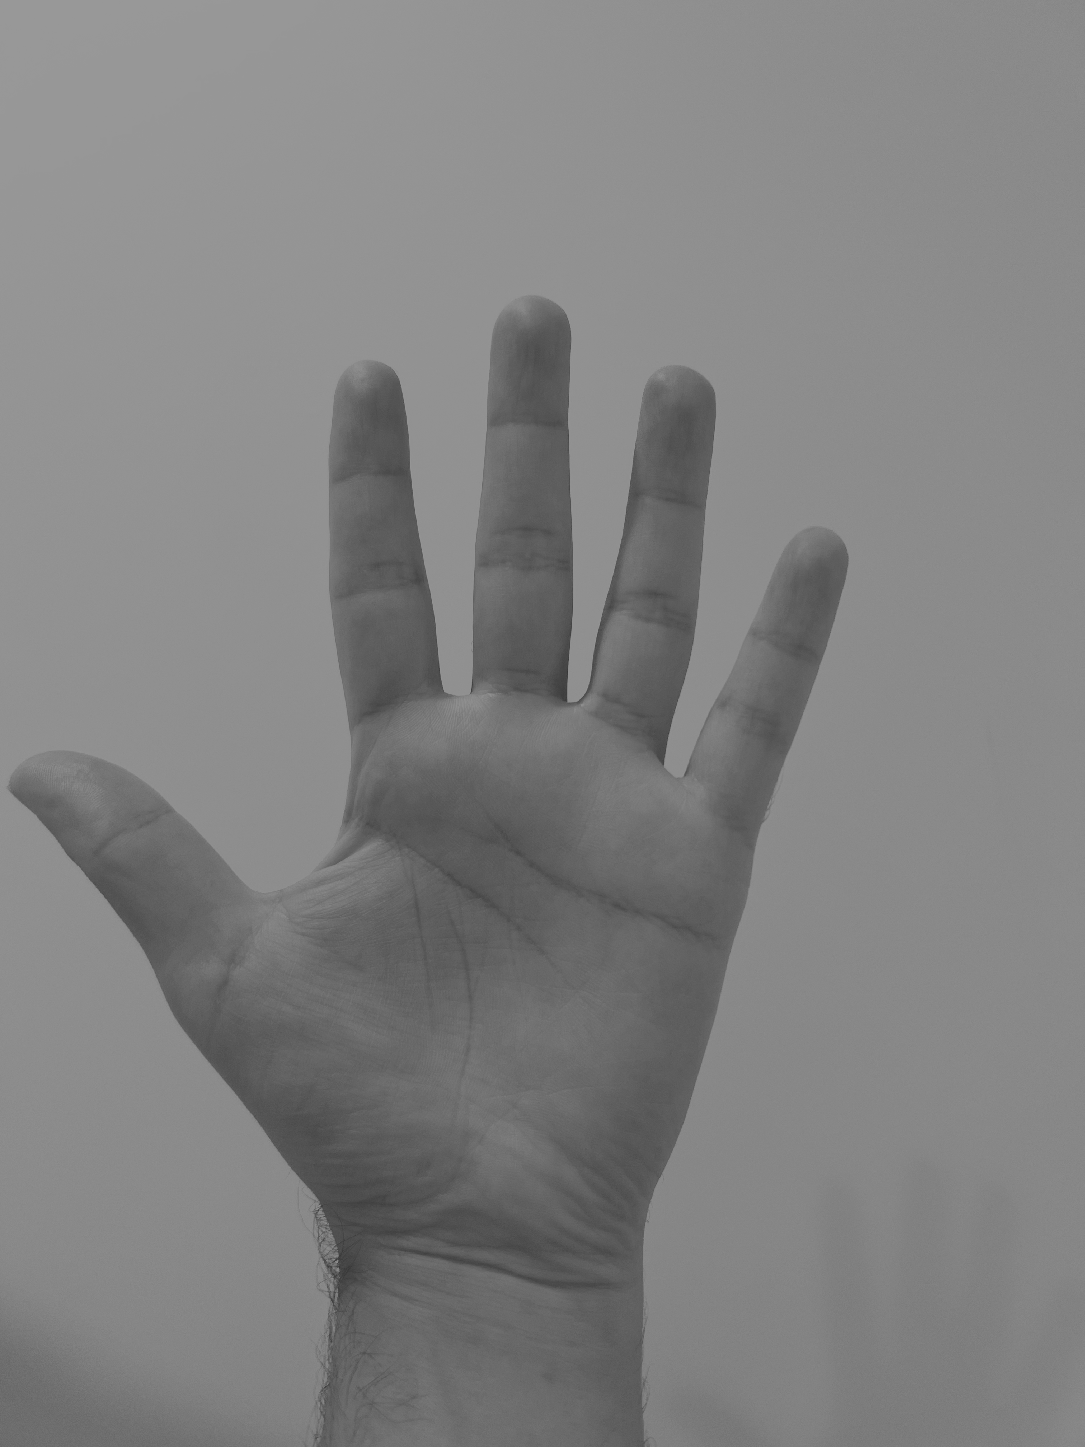
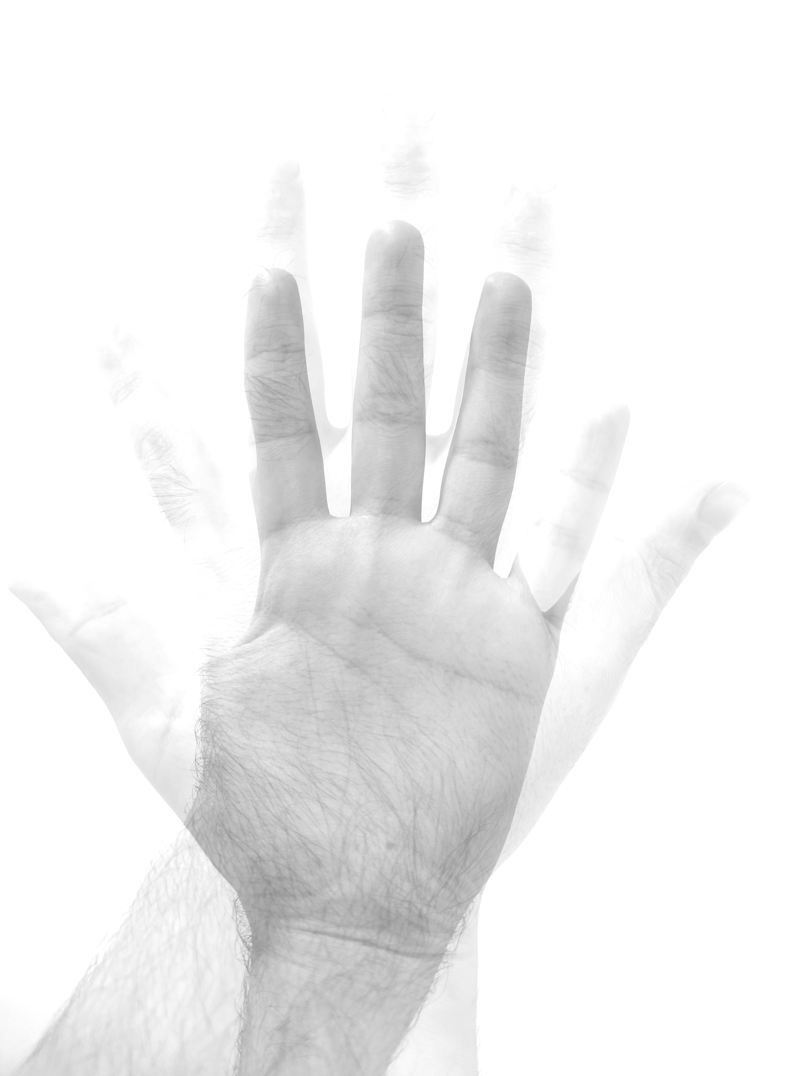
Add C(x,y) = A(x,y) + B(x,y)

Slide 9
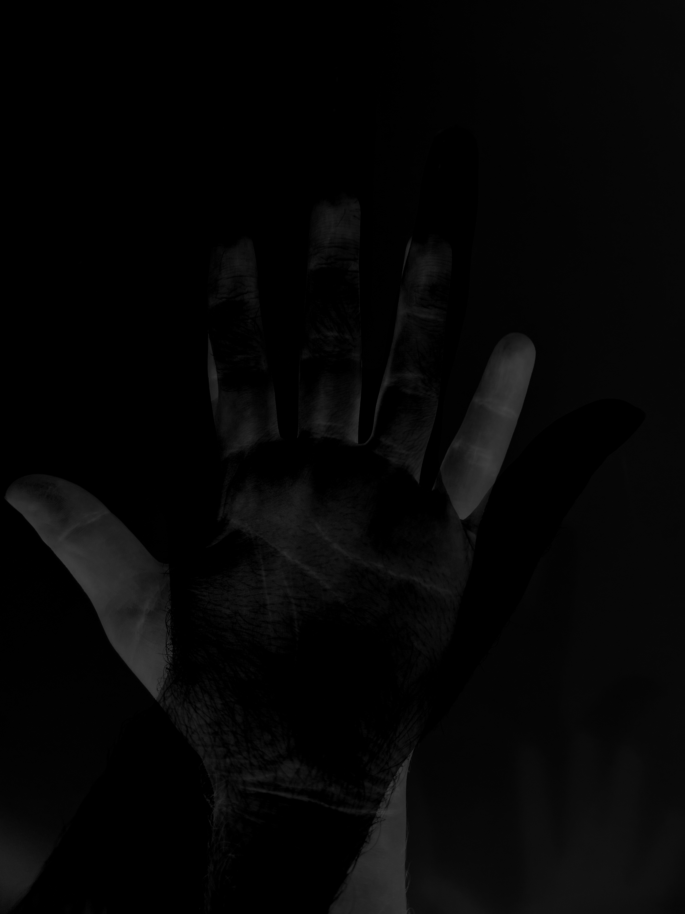
Sub C(x,y) = A(x,y) - B(x,y)

Slide 10
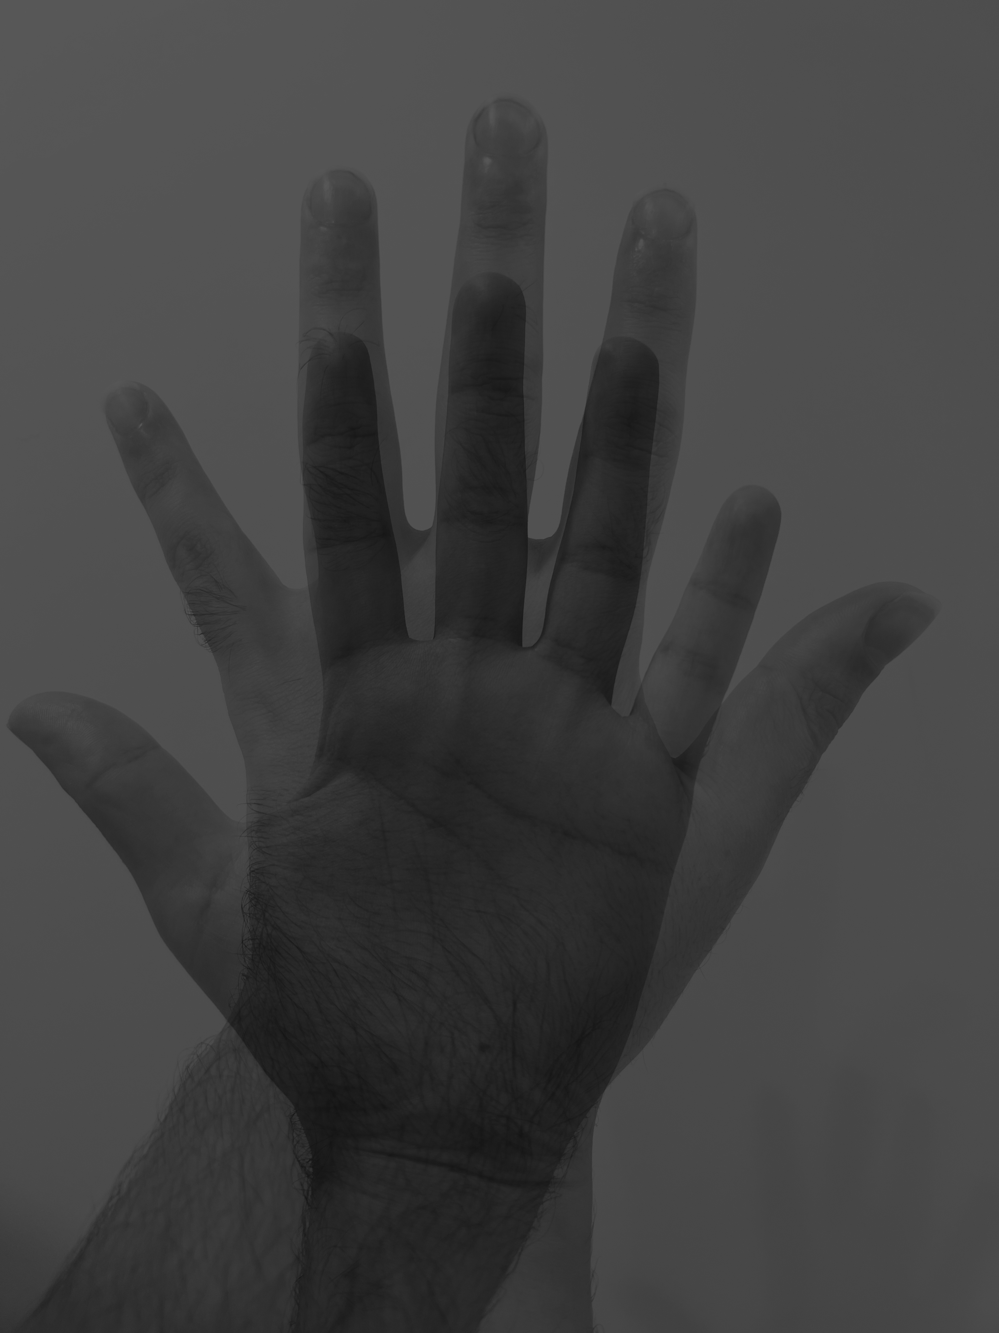
Mul C(x,y) = A(x,y) * B(x,y)

Slide 11
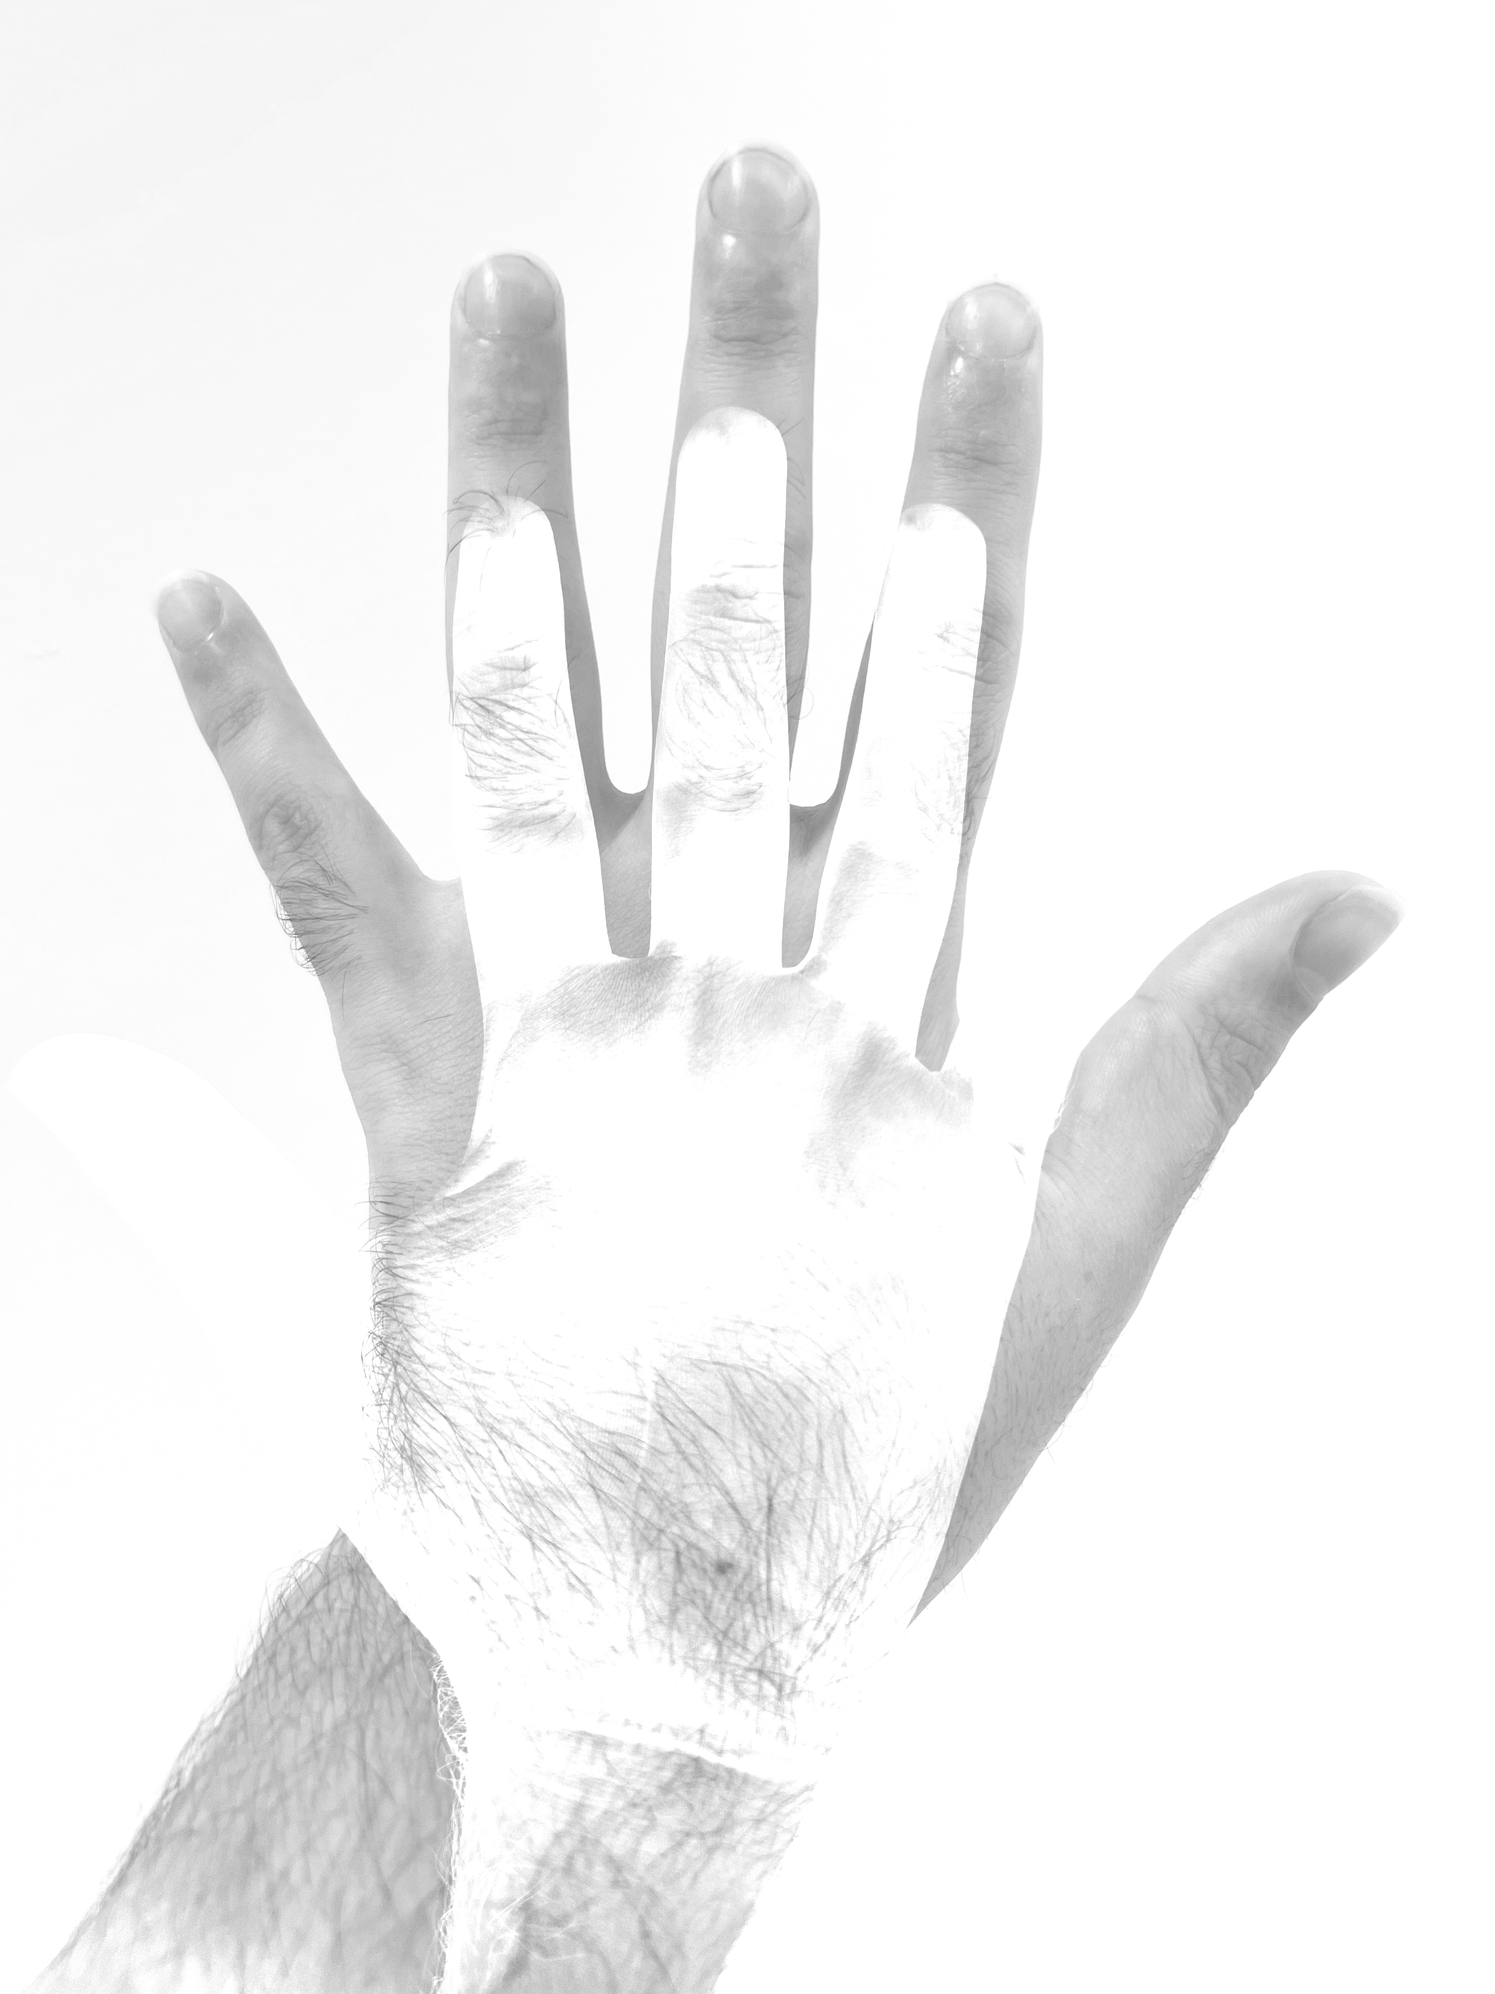
Div C(x,y) = A(x,y) / B(x,y)

Slide 12
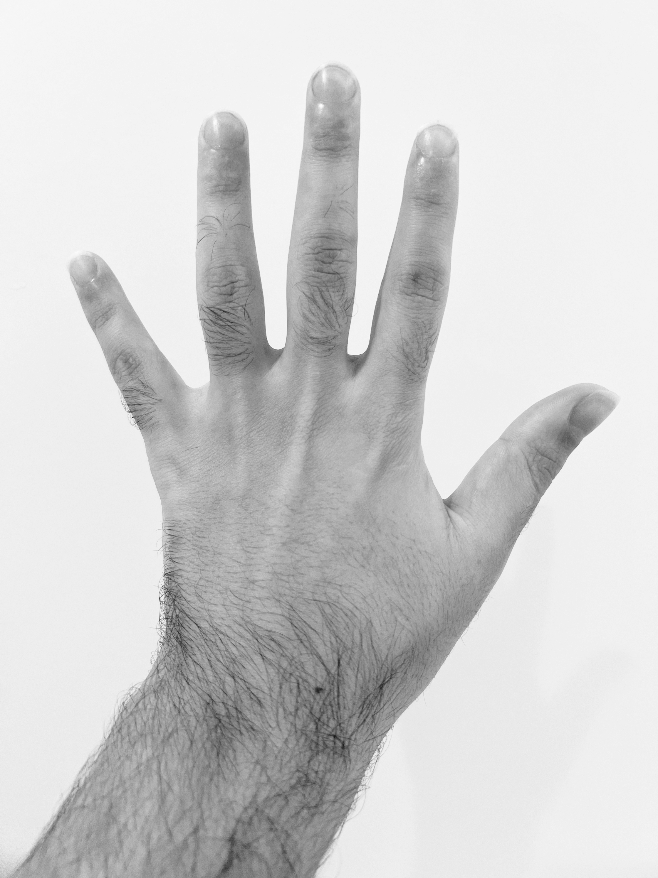
Log c = log(a)

Slide 13
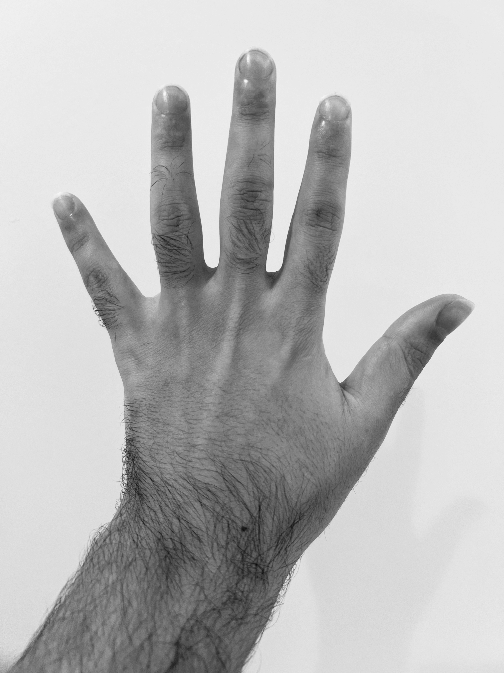
Exp c = exp(a)

Slide 14

Sqrt c = sqrt(a)

Slide 15
Orginal
Log
Exp
Sqrt

Slide 16
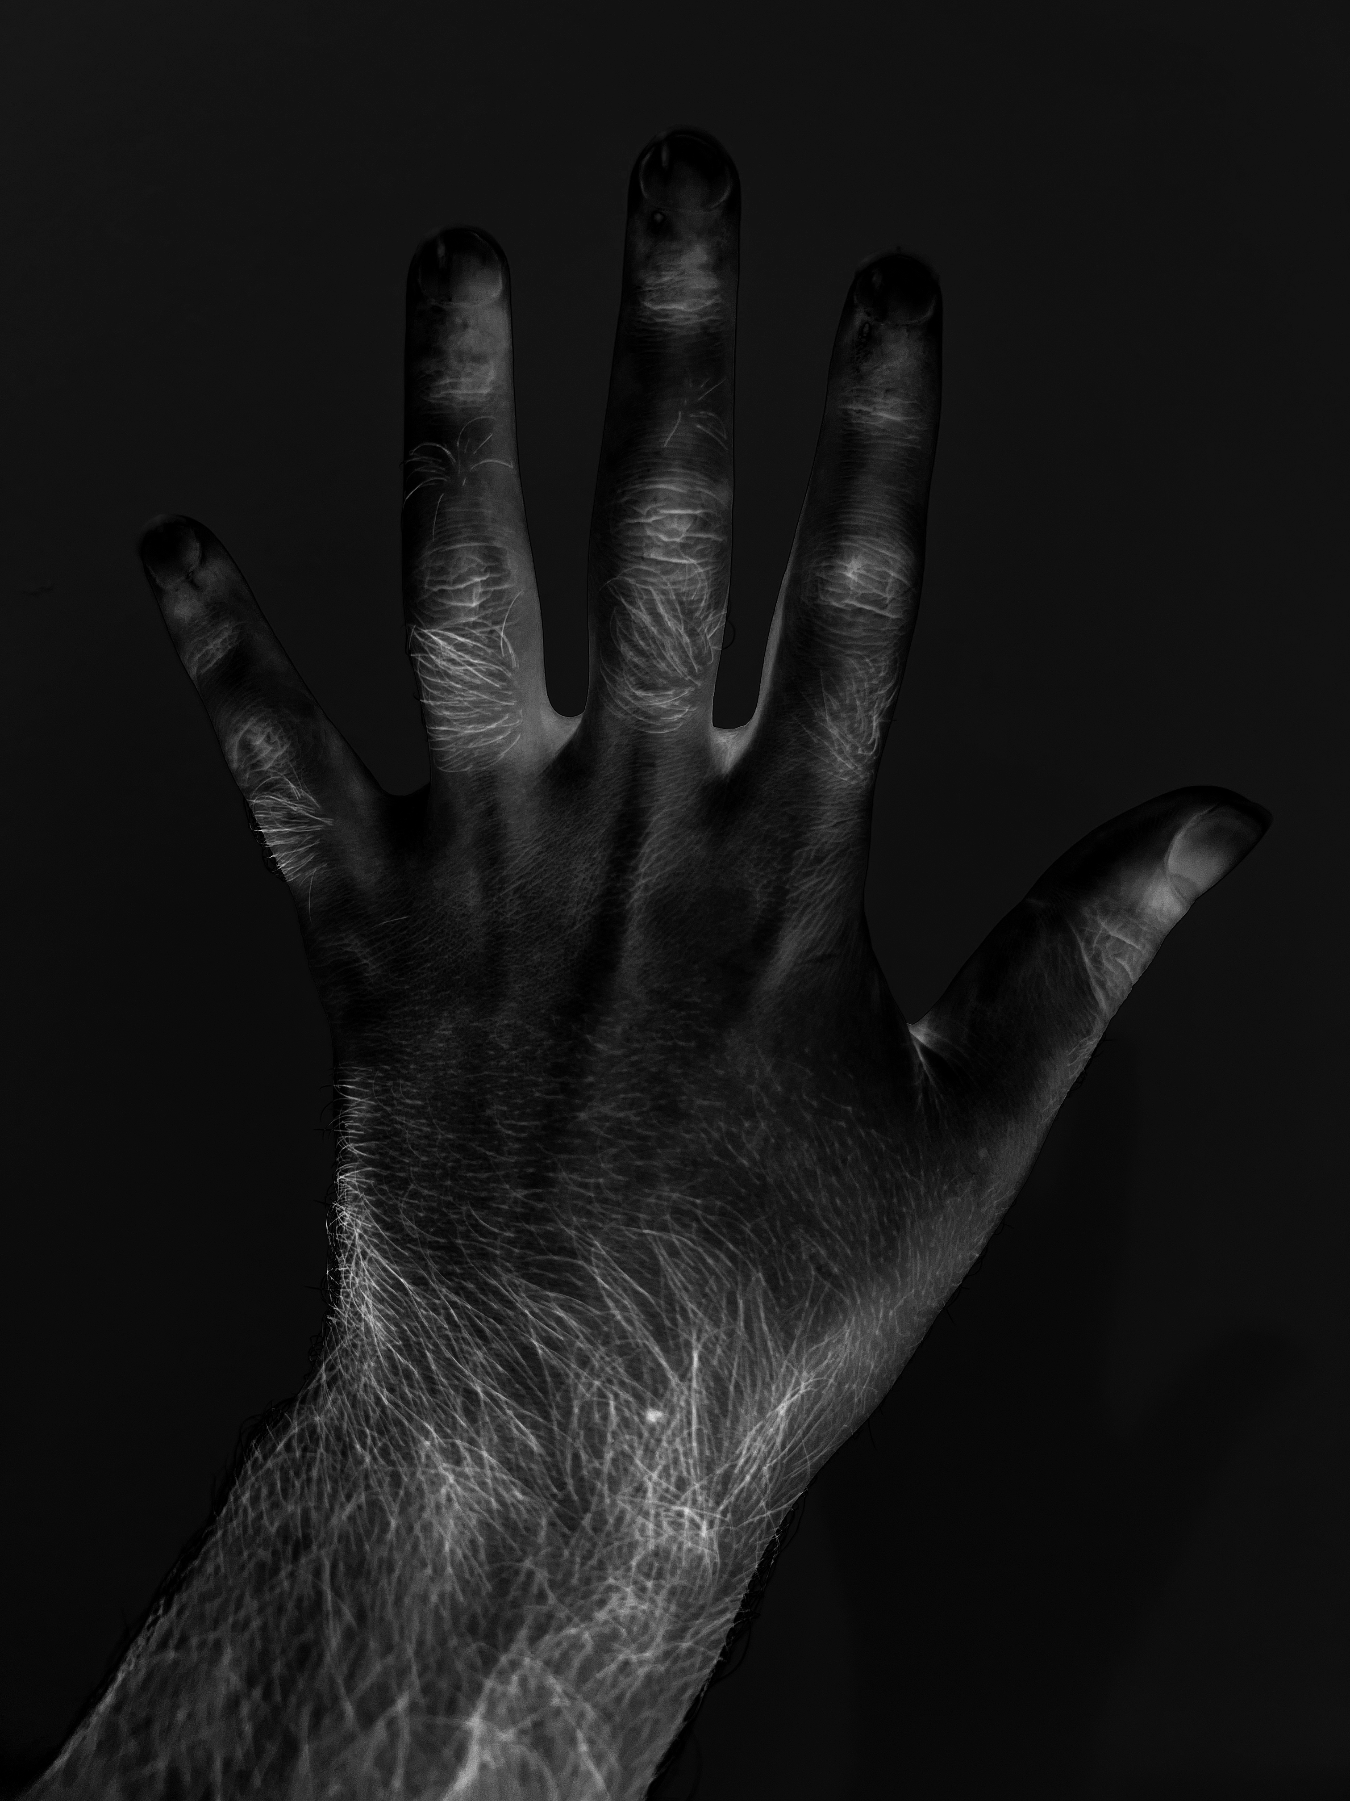

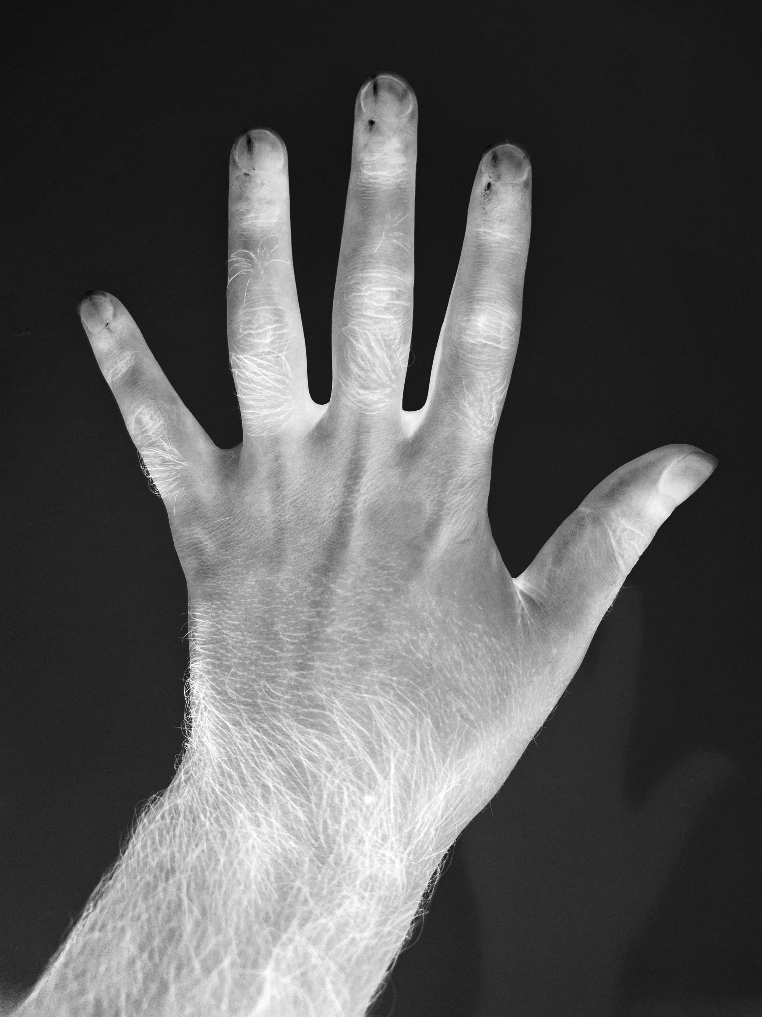
Trig C = Sin/Cos/Tan(a)
Orginal
Sin
Cos
Tan

Slide 17
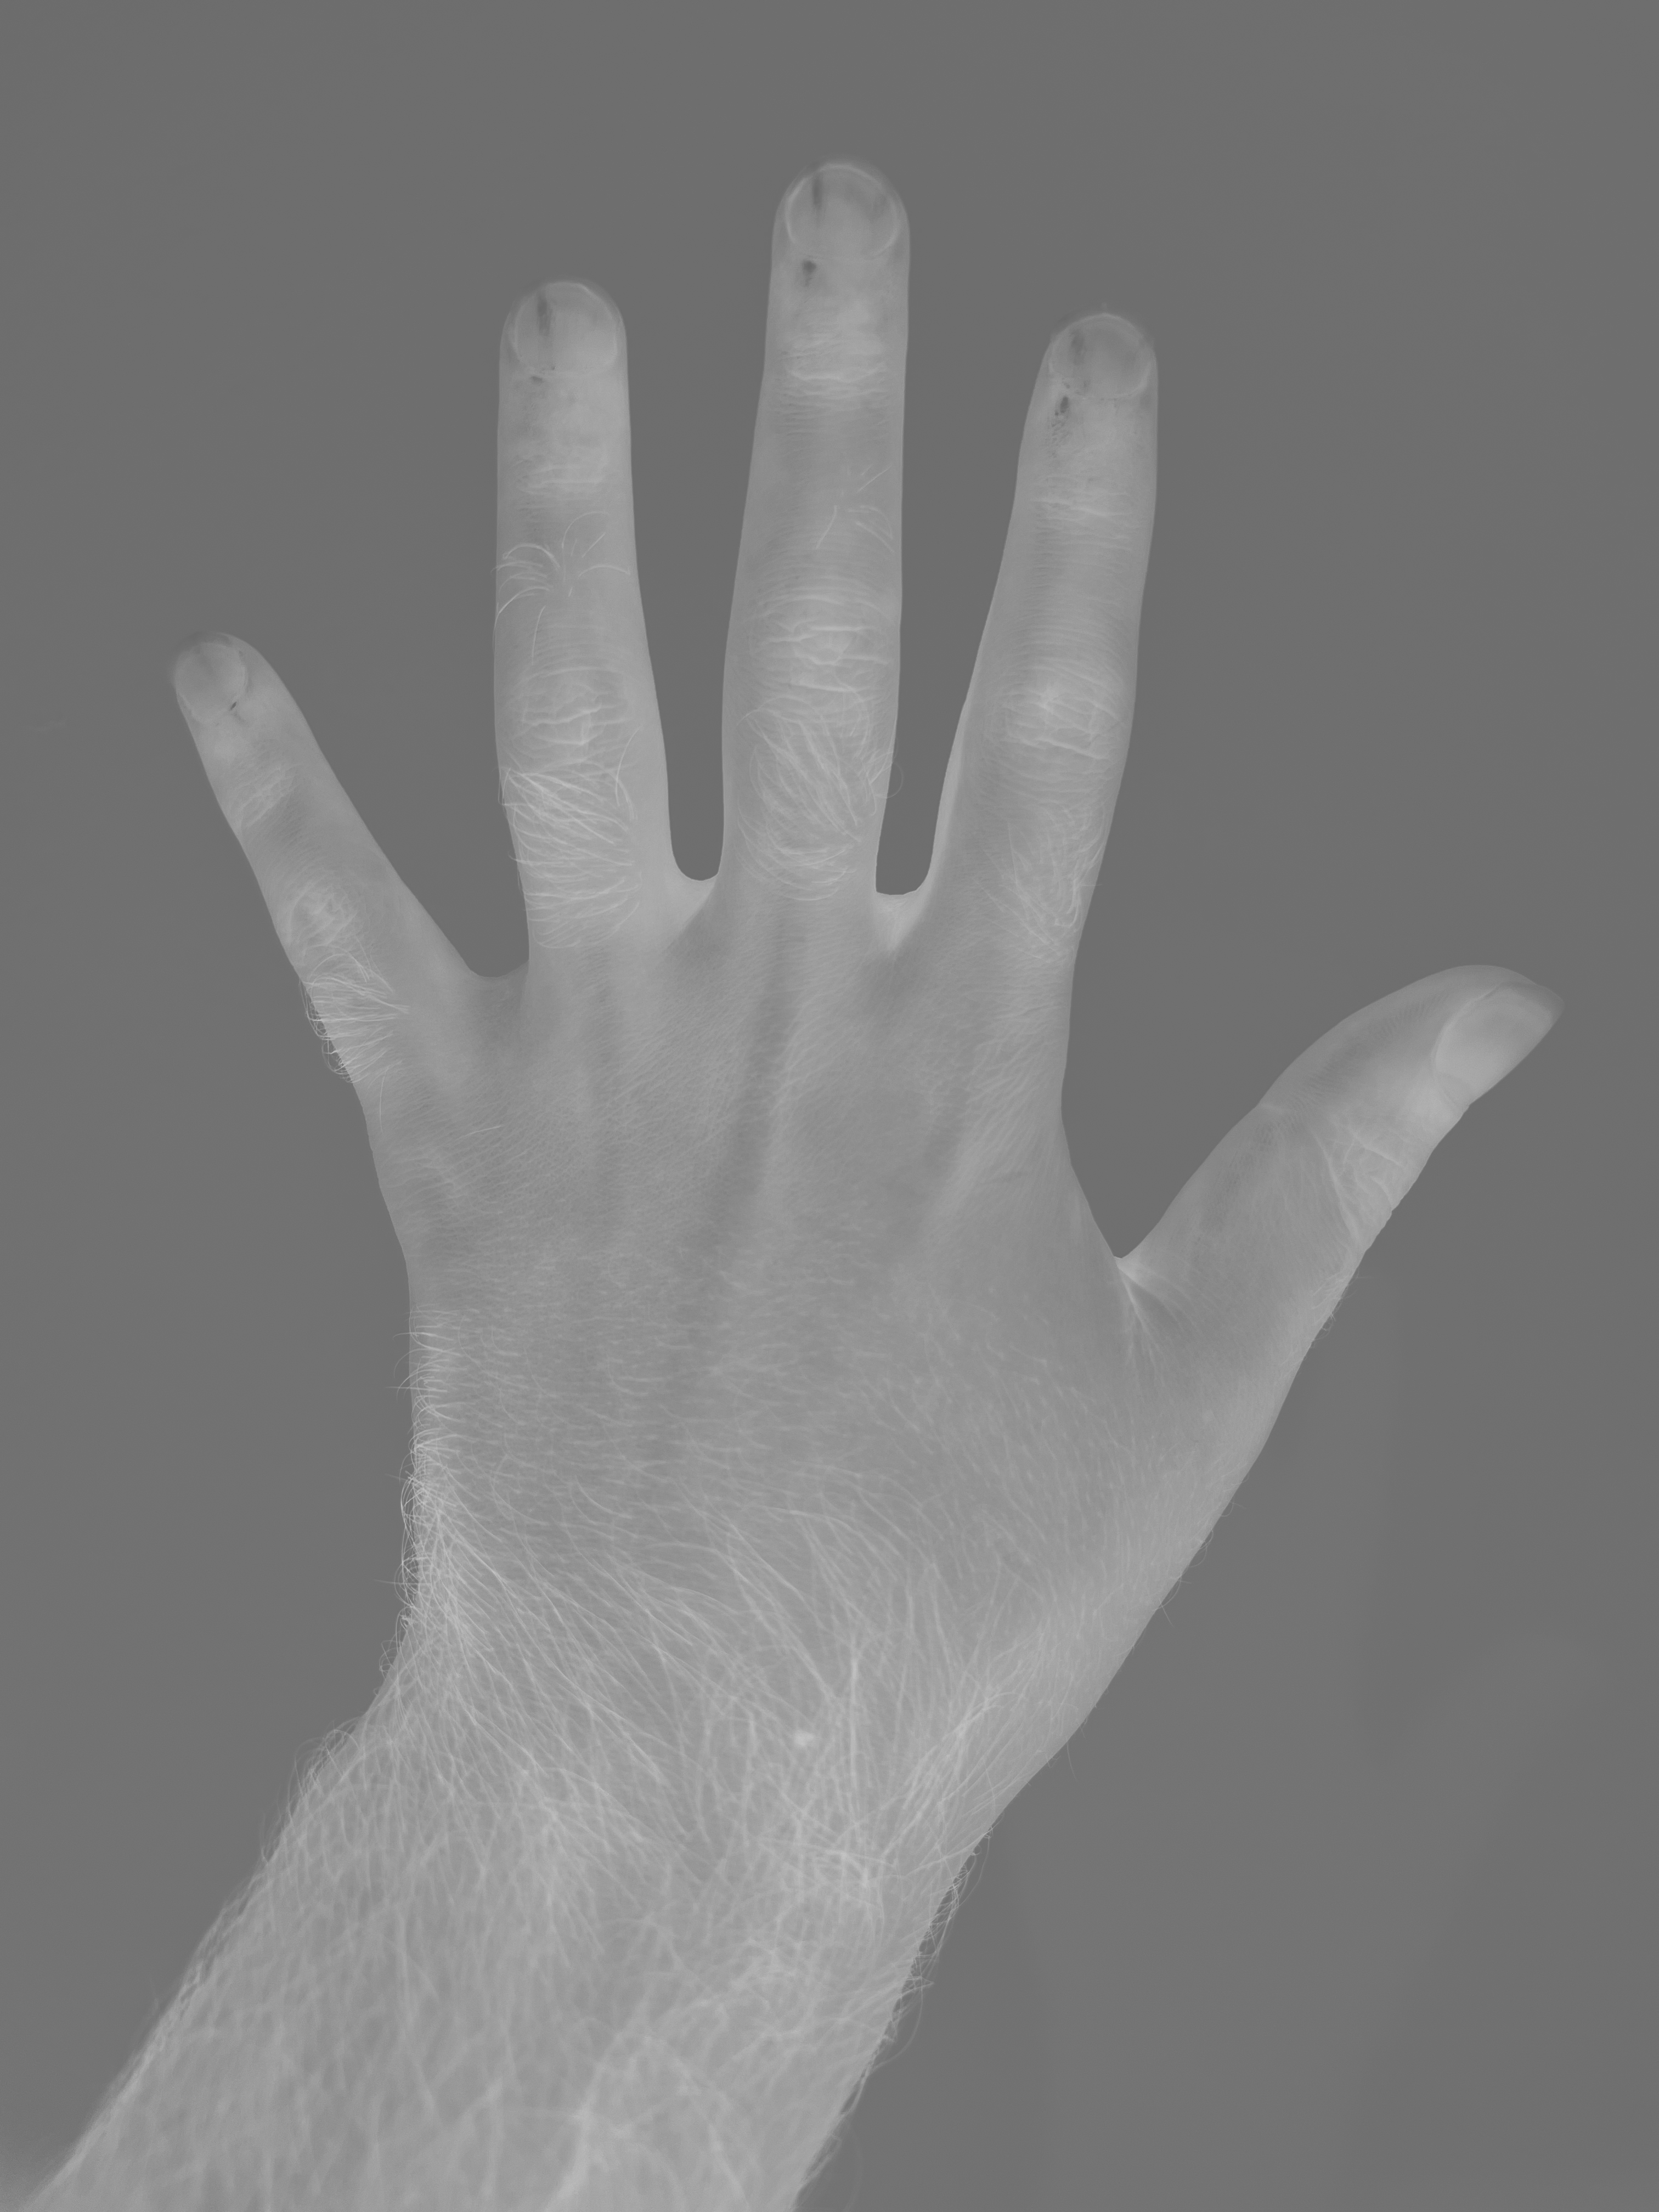
Invert (negative) C(x,y) = 255 - A(x,y) (for 8-bit images)

Slide 18
Conclusion
Basic operations form the foundation for more complex image processing techniques
Understanding pixel-level operations is crucial for developing advanced algorithms
Proper data type handling is essential for accurate results

Slide 19
Thank you
Umut Celik
umut.celik@cix.csi.cuny.edu
https://umutcelik.com.tr

